Slide 1


A FINAL REPORT TO OFFER ENGINEERING SOLUTIONS TO REDUCE THE URBAN AREA WILD BOAR POPULATION NEAR HEKİMKÖY COMPLEX, TÜRKBÜKÜ, BODRUM
Name: Yasemin Akın
School ID: 22101782
Class: ENG 401 004
Instructor: Marlene Denice Elwell

Slide 2
Contents
1.0 INTRODUCTION
2.0 PROBLEM DEFINITION
3.0 PROPOSED SOLUTIONS
4.0 CRITERIA FOR ASSESSING SOLUTIONS
5.0 RESEARCH METHODOLOGY
8.0 REFERENCES
6.0 RESULTS AND ANALYSIS
7.0 CONCLUSION AND RECOMMENDATIONS

Slide 3

1.0 Introduction

Slide 4
1.0 Introduction
1.1 PROBLEM:
The nature of the interaction between humans and wildlife has changed in urban and suburban environments [1].
An example of this shift is the increase in urban area wild boar population [2].

Slide 5
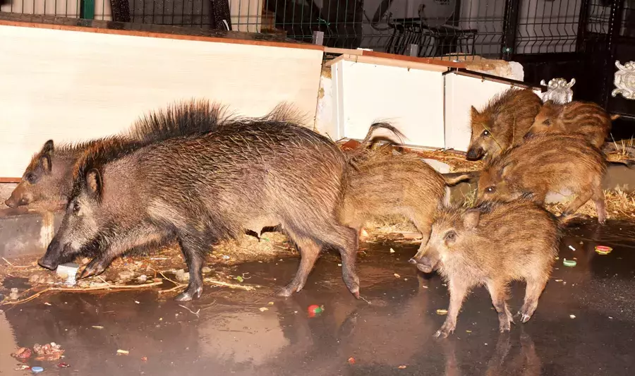
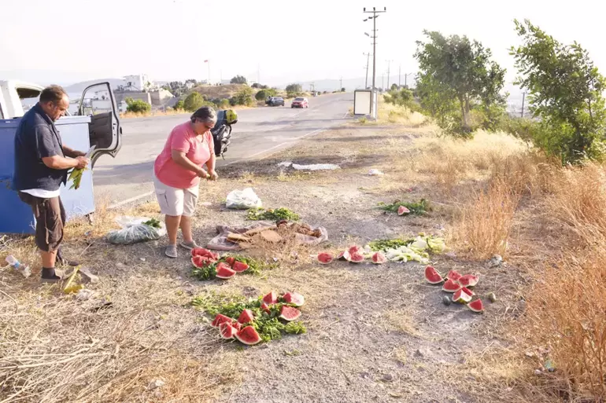
1.0 Introduction
1.1 PROBLEM:
Spread of wild boars into human-populated areas has created an alarming situation in the Hekimköy Complex (HC).
Simultaneous accommodation of wild boars and humans in the HC poses serious threats to human safety and property [3], [4].
Fig. 1: Wild Boars in HC [5]
Fig. 2: HC Residents Feeding Wild Boars Outside of the Complex to Keep Them Away [5]

Slide 6
1.0 Introduction
1.2 PROBLEM’S NEGATIVE IMPACTS:
Causing traffic accidents on dark roads at night
Causing pollution by knocking over garbage bins [5]
Carrying diseases [6]
Attacking and injuring HC residents

Slide 7
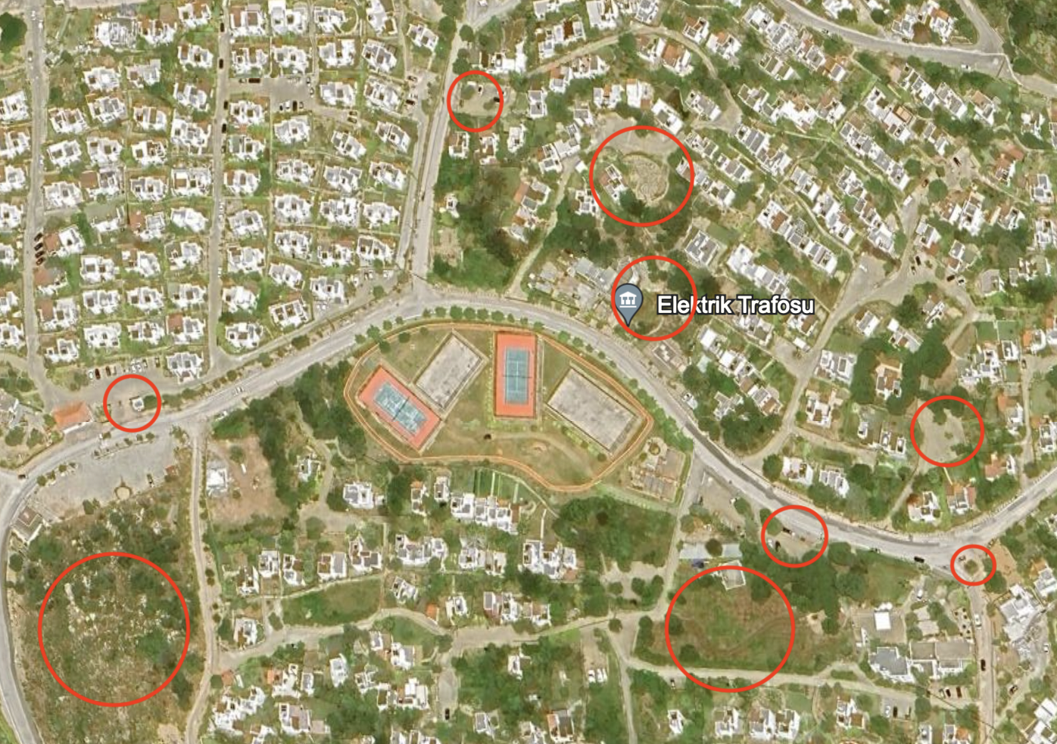
1.0 Introduction
1.3 PILOT STUDY AREA (PSA):
Hekimköy Complex, Türkbükü, Bodrum
Areas marked with red circles represent bush or garbage collection areas where wild boars are abundant.
Fig. 3: Aerial Eye View of HC [7]

Slide 8
1.0 Introduction
1.4 STUDY’S PURPOSE, IMPACT AND SIGNIFICANCE:
Reduce the wild boar population within the HC with the three engineering solutions
PURPOSE
Implement wild boar-deterring systems throughout the complex upon detecting wild boar presence in the complex, adding an extra layer of security for residents against wild boars
IMPACT
Study’s potential to generate solutions that can be adapted to all regions facing similar disturbances caused by wildlife, regardless of the type of animal species
SIGNIFICANCE

Slide 9

2.0 Problem definition

Slide 10
2.0 Problem defınıtıon
2.1 PROBLEM:
Wild boars in the PSA:
Cause traffic accidents
Damage to public infrastructure, parks, and private gardens [7] in the Hekimköy Complex
Raid rubbish bins and containers, creating an irritant to residents
Transmit diseases to pets and humans [8]
Pose a physical threat to people [4]

Slide 11
2.0 Problem defınıtıon
2.1 PROBLEM:
Overall, wild boars create an unsafe environment for outdoor activities within the HC [9].

Slide 12
2.0 Problem defınıtıon
2.2 ROOT CAUSES:
2.1.1 Easy Access to Food and Water [10]: In the forms of food wastes, vegetables, fruits
2.1.2 Insufficient Hunting Pressure [11]: Lack of lethal resources because of overpopulation
2.1.3 Expanding Urbanization into Forested Areas Occupied by Wild Boars [12]

Slide 13
2.0 Problem defınıtıon
2.3 PROBLEM SCOPE:
Who: Hekimköy Complex residents
What: Wild boar intrusion into urban areas through HC
When: Although the problem continues at all times of the year, its negative impacts increase in the summertime because of the increase in population in PSA due to summer holiday migrations [13].
Where: Hekimköy Complex, Türkbükü, Bodrum
Why: Increasing wild boar and human interactions lead to conflicts.
How: Causing car accidents, carrying diseases, damaging properties, creating pollution, and giving physical harm to people [7]

Slide 14

3.0 Proposed solutions

Slide 15
3.0 Proposed solutıons
Three engineering solutions were proposed to address the problem in the PSA:
3.1 Kinect-Based Deterrent System with an Odor-Repellent
3.2 Machine Learning-Based Acoustic Deterrent System
3.3 Sensor and Artificial Intelligence-Based Visual Deterrent System

Slide 16
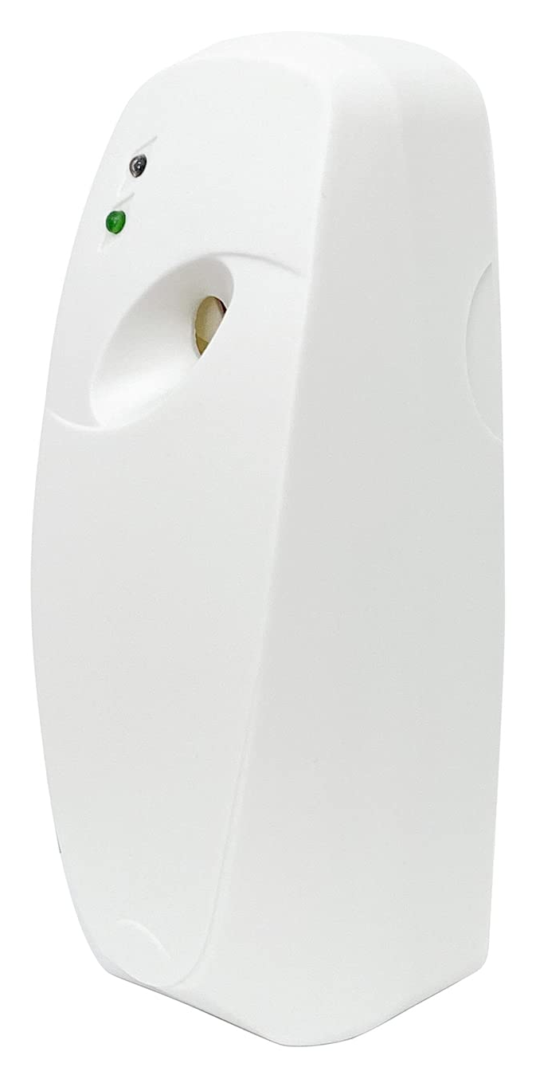
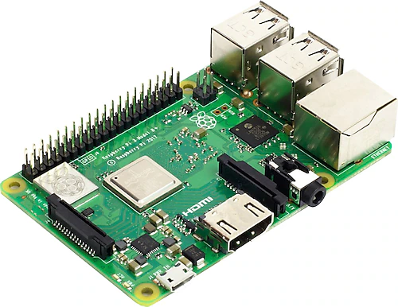
3.0 Proposed solutıons
3.1 KINECT-BASED DETERRENT SYSTEM WITH AN ODOR-REPELLENT
The system will consist of three pieces of hardware: a Kinect camera, a control unit, and an odor dispenser [14].
Where?
On streetlamps within areas with a high concentration of wild boar sightings within PSA [16], [20]:
Garbage collection areas
Overgrown areas throughout the complex
Who?
PSA electricians will handle the physical installation, and a software engineer will set up the necessary software programs in the programmable logic controller.
How Many?
28 systems → 12 near four main garbage collection areas, 16 near eight big bushlands
Fig. 6: Odor Dispenser [15]
Fig. 5: Programmable Microcontroller [14]

Slide 17
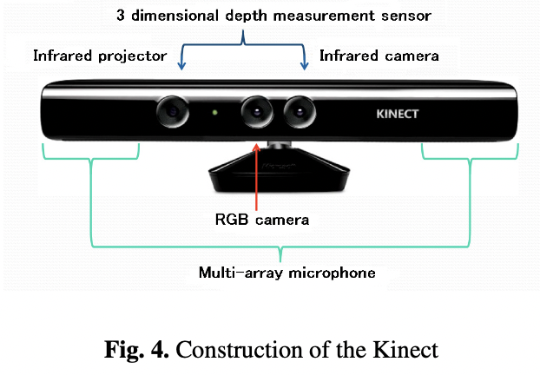
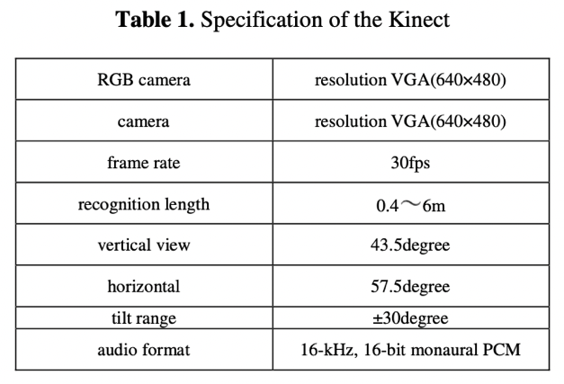
3.0 Proposed solutıons
3.1 KINECT-BASED DETERRENT SYSTEM WITH AN ODOR-REPELLENT
About the Kinect Camera:
“Kinect for Xbox” is a motion-sensing device usually used for gaming [16].
Kinect can create a 3D depth map of its surroundings, allowing it to track the position and movements of objects. Therefore, used for depth-sensing and motion-tracking systems applications [17].
Fig. 4: Kinect Construction [18]
Table 1: Kinect Specifications [18]

Slide 18
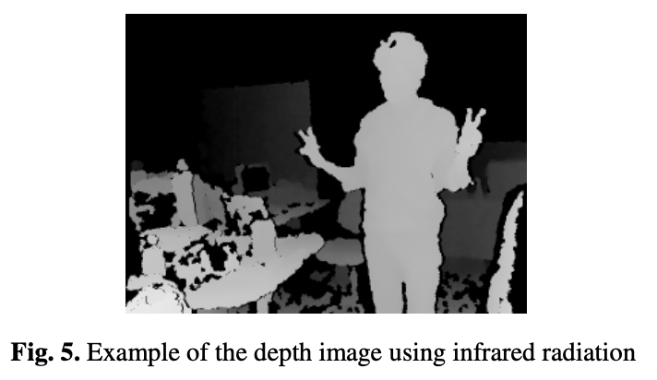
3.0 Proposed solutıons
3.1 KINECT-BASED DETERRENT SYSTEM WITH AN ODOR-REPELLENT
Phase 1 - Image Acquisition: (Kinect will be repurposed as an efficient automatic capturing device in this context.)
1. Obtain distance information using Kinect’s infrared projection and camera [18]
2. Kinect uses distance information to create a depth image of the object [18].
Fig. 7: Example of the Depth Image Using Infrared Radiation [18]

Slide 19
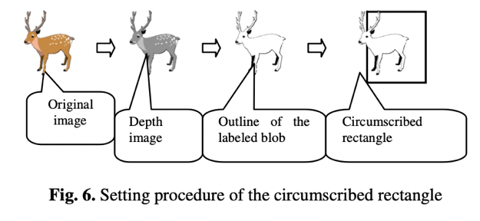
3.0 Proposed solutıons
3.1 KINECT-BASED DETERRENT SYSTEM WITH AN ODOR-REPELLENT
Phase 2 - Detection:
1. Blob analysis by using the shape and size of the object is applied to the depth image, which is an analysis method for object detection [17].
2. Shape and size resemblance of the animals may mislead blob analysis so an extra layer of motion detection will be applied by utilizing the optical flow method on the depth image [18].
Fig. 8: Setting Procedure of the Circumscribed Rectangle [18]

Slide 20
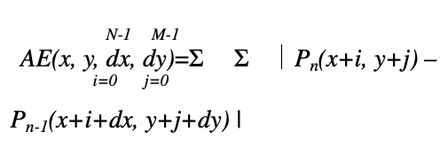
3.0 Proposed solutıons
3.1 KINECT-BASED DETERRENT SYSTEM WITH AN ODOR-REPELLENT
Phase 3 - Odor-Repellent Secretion:
1. Signal identification
2. Control unit, programmable logic controller (PLC), interprets the signal
3. Communication with odor-repellent dispenser
4. Release of “Wildschwein-StoppÒ” [19] from the dispenser
Fig. 9: Mathematical Description of Optical Flow Method (Here, AE is the block matching value on the block (N×M), P is the frame, and dx and dy denote motion vectors.) [18]

Slide 21
3.0 Proposed solutıons
3.2 MACHINE LEARNING-BASED ACOUSTIC DETERRENT SYSTEM
Solution Components:
Raspberry Pi 3B (Rpi) microcontroller [21]
Rpi infrared night vision camera [22]
Python OpenCV library [23]
Machine Learning (ML) model built on the Convolutional Neural Network (CNN) architecture [24], [25]
Ultrasonic frequency generator [24], [26]
Amplifier [24] (occasionally)
Module casing [24]

Slide 22
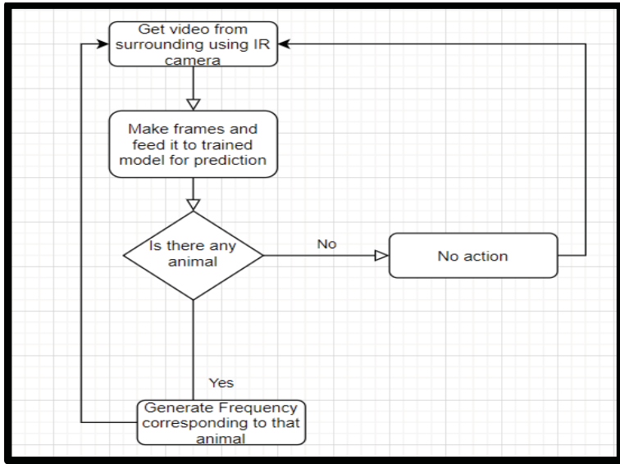
3.0 Proposed solutıons
3.2 MACHINE LEARNING-BASED ACOUSTIC DETERRENT SYSTEM
Camera continuously records the video of its surroundings.
Rpi captures frames at some rate.
The Python OpenCV library processes the frames to prepare them for the detection step [26].
Image recognition is performed using a Convolutional Neural Network (CNN) machine learning model, trained with a dataset of wild boar images for accurate identification [27], [28].
Rpi sends a signal to an ultrasonic frequency generator upon identifying wild boars.
The ultrasonic repellent produces frequencies that will annoy wild boars, within the range audible to wild boars but not humans [24], [29].
Fig. 10: Solution Network Diagram [24]

Slide 23
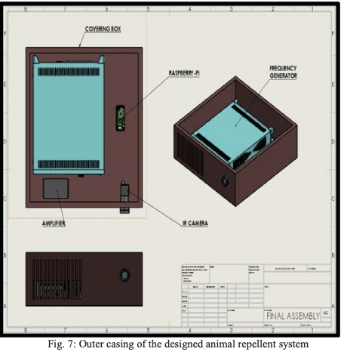
3.0 Proposed solutıons
3.2 MACHINE LEARNING-BASED ACOUSTIC DETERRENT SYSTEM
Based on the sizes of all hardware components, an outer casing will be designed to hold and protect the hardware [24], [30].
This casing will then be placed over streetlights in the PSA, especially near rubbish collection areas, rubbish bins, and vacant bushland [25].
How many?: 28 systems on 28 streetlights will be installed
Who?: Rpi will be set up by a software engineer, and physical installation on streetlights will be handled by HC electricians.
Fig. 11: Designed Animal Repellent System Outer Casing [24]

Slide 24
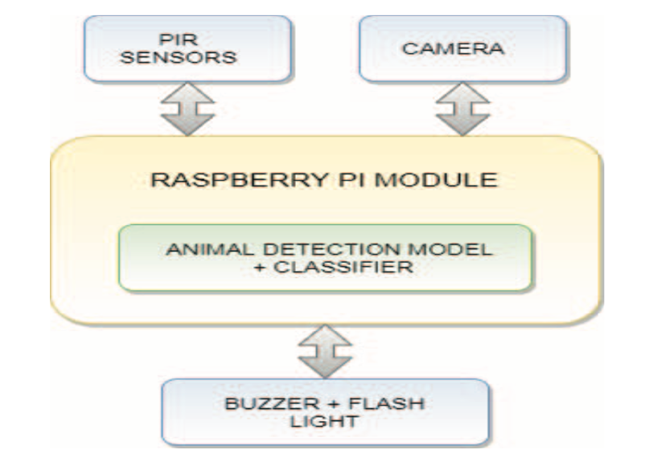
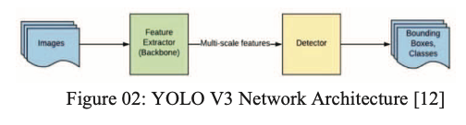
3.0 Proposed solutıons
3.3 SENSOR AND ARTIFICIAL INTELLIGENCE-BASED VISUAL DETERRENT SYSTEM
System Components [31]:
Passive infrared motion (PIR) sensors (to sense warm objects around) x 3
Animal detection model (YOLO V3) x 1
Camera x 1
Rpi x 1
Light-emitting diode (LED) light strips x 3
LED LIGHT
Fig. 12: System Architecture Block Diagram [31]
Fig. 13: YOLO V3 Network Architecture [31]

Slide 25
3.0 Proposed solutıons
3.3 SENSOR AND ARTIFICIAL INTELLIGENCE-BASED VISUAL DETERRENT SYSTEM
PIR sensors are placed where wild boars are frequently observed.
PIR sensors detect motion by sensing variations in infrared radiation and can identify warm objects in their field of vision [31].
When a large, warm object like a wild boar enters the sensor's view, it triggers motion detection.
Camera records live streaming when motion is detected and stores the video on the Rpi.
The YOLO V3 algorithm is used for animal species identification in the detection phase.
YOLO V3 predicts detected object classes and bounding boxes within a single algorithm pass [31].
If wild boars are detected, the system activates an LED light to deter them.
The LED light blinks irregularly to annoy and guide the wild boar away from the urban area without causing harm.

Slide 26
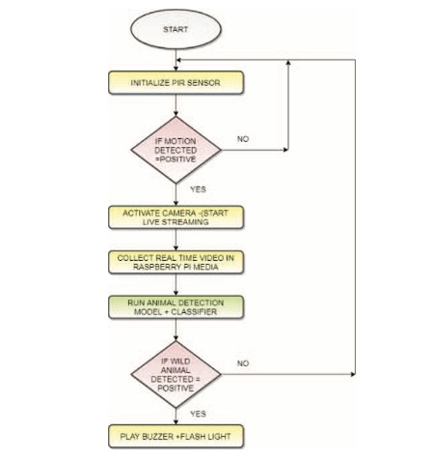
3.0 Proposed solutıons
3.3 SENSOR AND ARTIFICIAL INTELLIGENCE-BASED VISUAL DETERRENT SYSTEM
Who?
A software engineer will set up Rpi modules with the necessary software; HC electricians will do the physical installation.
How Many?
28 systems will be installed in the PSA.
LED LIGHT
Fig. 14: Flow Chart for System [31]

Slide 27

4.0 criteria for assessing solutions

Slide 28
4.0 Criteria for Assessing Solutions
The engineering solutions will be assessed against three criteria:
4.1 Feasibility (35%): The solutions' applicability, practicality, and acceptability affect their possibility of being used in real life.
4.2 Monetary Cost (35%): The monetary costs of the products affect their possibility of being used in real life because they must fit the budget
4.3 Environmental Safety Impact (30%): For the solutions to be applied, the deterrents that are used in the systems must not harm the environment.

Slide 29
4.0 Criteria for Assessing Solutions
4.1 FEASIBILITY
The solutions’ feasibility [32] will be evaluated by the following:
Kinect-Based Deterrent System with an Odor-Repellent | Machine Learning-Based Acoustic Deterrent System | Sensor and Artificial Intelligence-Based Visual Deterrent System
To verify the system’s operational functionality [18] To evaluate the time and labor required for the system’s construction [20] To assess the system installation locations to avoid disturbing PSA residents [34] | To check the performance of the organization [24], [25] To estimate the amount of time and work needed to build the structure [26] | To control the functionality of the system’s operation [31], [33] To calculate how much time and work will be needed to build the organization [33] To prevent disturbing PSA inhabitants, the system installation locations are evaluated [34]
Table 2: Feasibility Criterion
Notes:
The feasibility of the solutions will be assessed by evaluating their operational functionality for applicability, time and labor requirements for construction for practicality and the availability of installation areas that will not disturb Hekimköy residents for acceptability.

Slide 30
4.0 Criteria for Assessing Solutions
4.2 MONETARY COST
The solutions’ monetary cost [35] will be checked by the following:
Kinect-Based Deterrent System with an Odor-Repellent | Machine Learning-Based Acoustic Deterrent System | Sensor and Artificial Intelligence-Based Visual Deterrent System
Cost of acquiring hardware components and the required software [36] To maintain the optimal allocation of financial resources of PSA [37] Ongoing sustainability costs [19] | The price of purchasing the necessary software and hardware components [28] To preserve the best possible distribution of PSA’s financial resources Continual expenses for sustainability [38] | Expenses of purchasing important hardware and software components[39]. To keep PSA’s financial resources distributed as efficiently as possible [40]. Frequent expenses for sustainability [41]
Table 3: Monetary Cost Criterion
Notes:
Solutions will be assessed against monetary cost criterion by calculating the costs of the systems, for both construction and sustainability. And also available financial resources will be assessed here too.

Slide 31
4.0 Criteria for Assessing Solutions
4.3 ENVIRONMENTAL SAFETY IMPACT
The solutions’ environmental safety impact [38] will be assessed by the following:
Kinect-Based Deterrent System with an Odor-Repellent | Machine Learning-Based Acoustic Deterrent System | Sensor and Artificial Intelligence-Based Visual Deterrent System
Whether the odor-repellent is harmful to the environment [22], [23] | Whether the ultrasonic frequency range to be used as an acoustic deterrent is harmful to other living organisms [30], [42] | Whether the use of visual repellent, a LED light, is harmful to other animals [22], [23], [43]
Table 4: Environmental Safety Impact Criterion
Notes:
The environmental safety impacts of the solutions will be assessed by evaluating the percentage of possible harm that may come from the repellent elements used in each solution

Slide 32

5.0 research methodology

Slide 33
5.0 Research Methodology
To assess the engineering solutions with the criteria, three methods will be used:
5.1 Literature Review
5.2 Market Research
5.3 Field Observation

Slide 34
5.0 Research Methodology
5.1 LITERATURE REVIEW
All solutions will be assessed against all criteria by the literature review [44], [45] method:
 | Kinect-Based Deterrent System with an Odor-Repellent | Machine Learning-Based Acoustic Deterrent System | Sensor and Artificial Intelligence-Based Visual Deterrent System
Literature Review | Feasibility [18], [20], [39] Monetary Cost [19] Environmental Safety Impact [22], [23] | Feasibility [24], [25], [26] Monetary Cost [28], [40] Environmental Safety Impact [30], [42] | Feasibility [31], [32], [33] Monetary Cost [41] Environmental Safety Impact [43]
Table 5: Literature Review Method

Slide 35
5.0 Research Methodology
5.2 MARKET RESEARCH
All solutions will be evaluated against monetary cost criterion by the market research [46] method:
 | Kinect-Based Deterrent System with an Odor-Repellent | Machine Learning-Based Acoustic Deterrent System | Sensor and Artificial Intelligence-Based Visual Deterrent System
Market Research | Monetary Cost [47] | Monetary Cost [40] | Monetary Cost [48]
Table 6: Market Research Method

Slide 36
5.0 Research Methodology
5.3 FIELD OBSERVATION
All solutions will be checked against feasibility and environmental safety impact criteria by the field observation [49], [50] method:
 | Kinect-Based Deterrent System with an Odor-Repellent | Machine Learning-Based Acoustic Deterrent System | Sensor and Artificial Intelligence-Based Visual Deterrent System
Field Observation | Feasibility Environmental Safety Impact | Feasibility Environmental Safety Impact | Feasibility Environmental Safety Impact
Table 7: Field Observation Method

Slide 37

6.0 Results and Analysis

Slide 38
6.0 RESULTS AND ANALYSIS
CRITERIA WEIGHING
All solutions were analyzed for each criterion with varying weights.
Chart 1: Criteria Weighing and Justification Pie Chart Illustration

Slide 39
6.0 RESULTS AND ANALYSIS
Score distribution for each criterion:
CRITERIA | TOTAL INDICATORS | ATTAINABLE SCORES | WEIGHT AND NORMALIZATION FACTORS | WEIGHTED AND NORMALIZED SCORES
Feasibility | 4 | 10 | 3.50 | [0-35]
Monetary Cost | 3 | 8 | 4.38 | [0-35]
Environmental Safety Impact | 2 | 5 | 6.00 | [0-30]
Table 8: Score and Indicator Distribution per Criterion

Slide 40
6.0 RESULTS AND ANALYSIS
6.1 FEASIBILITY ASSESSMENT
Feasibility criterion checklist:
Indicators | Score Interval | Comments
Integration into Existing Infrastructure | [0-3] | (0) Complete overhaul required (1) Major modifications needed (2) Minor modifications sufficient (3) No modifications needed
Technology or Method Availability and Maturity | [0-2] | (0) Technology/method undeveloped or experimental (1) Technology/method available, limited testing (2) Technology/method widely available, proven effective
HC Community Acceptance | [0-2] | (0) Strong opposition, significant acceptance barriers (1) Some resistance, requires persuasion (2) Accepted with support, minimal concerns
Technical Implementation | [0-3] | (0) Extremely complex, specialized skills required (1) Considerable complexity, and external expertise needed (2) Manageable complexity with existing resources (3) Straightforward, easily managed
Possible Total Points | 10
Table 9: Feasibility Criterion Checklist

Slide 41
6.0 RESULTS AND ANALYSIS
6.1 FEASIBILITY ASSESSMENT
6.1.1 KINECT-BASED DETERRENT SYSTEM WITH AN ODOR-REPELLENT FEASIBILITY CHECKLIST
INDICATORS | SCORES | COMMENTS
Integration into existing infrastructure | 2 | Minor installation adjustments are needed [17]; the infrastructure is largely compatible
Technology or method availability and maturity | 2 | Kinect is a mature, tested technology ready for application [18]. BLOB analysis is a successful object detection algorithm [17], [18].
HC community acceptance | 1 | Potential odor concerns [21], may require community persuasion [22]
Technical implementation | 0 | Installation complex [14]; requires specialized skills but manageable [15]. Requires monthly renewal of the odor repellent [22]
Table 10: Feasibility Criterion Checklist for Kinect-Based Deterrent System With An Odor-Repellent

Slide 42
6.0 RESULTS AND ANALYSIS
6.1 FEASIBILITY ASSESSMENT
6.1.2 MACHINE LEARNING-BASED ACOUSTIC DETERRENT SYSTEM FEASIBILITY CHECKLIST
INDICATORS | SCORES | COMMENTS
Integration into existing infrastructure | 2 | Requires some installation on streetlights; relatively compatible [23]
Technology or method availability and maturity | 1 | Machine learning is advanced [24], but the application for wild boars is novel.
HC community acceptance | 2 | Likely accepted; non-invasive and no odor issues [30]
Technical implementation | 1 | Complex setup with ML and computer vision [28]; specialized skills required [25], [26], [28]
Table 11: Feasibility Criterion Checklist for Machine Learning-Based Acoustic Deterrent System

Slide 43
6.0 RESULTS AND ANALYSIS
6.1 FEASIBILITY ASSESSMENT
6.1.3 SENSOR AND ARTIFICIAL INTELLIGENCE-BASED VISUAL DETERRENT SYSTEM FEASIBILITY CHECKLIST
INDICATORS | SCORES | COMMENTS
Integration into existing infrastructure | 2 | Installation on streetlights needed; minor integration effort [25]
Technology or method availability and maturity | 2 | PIR sensors [31] and Rpi [22] are mature; YOLO V3 is a proven AI model [31].
HC community acceptance | 2 | High acceptance is likely. The system is discreet and non-disruptive to the HC residents.
Technical implementation | 1 | It requires the setup of an AI model [33] and sensor calibration [32]. Technical expertise is needed [34], [35].
Table 12: Feasibility Criterion Checklist for Sensor And Artificial Intelligence-Based Visual Deterrent System

Slide 44
6.0 RESULTS AND ANALYSIS
($1 = 28.92 ₺)
(€1 = 31.33 ₺) [51]
6.2 MONETARY COST ASSESSMENT
Monetary cost criterion checklist:
INDICATORS | BUDGET (Annual monetary expense is %5 of annual dues income.) | SCORE INTERVAL | COMMENTS
Product costs | 200000 ₺ | [0-3] | (0) Exceeds budget significantly (1) Requires a substantial portion of the budget (2) Moderate cost within budget (3) Low cost, well within budget
Installation (labor) cost | 10000 ₺ | [0-3] | (0) Exceeds budget significantly (1) Requires a substantial portion of the budget (2) Moderate cost within budget (3) Low cost, well within budget
Ongoing operational expenses post-implementation | 15000 ₺ per month | [0-2] | (0) High recurring costs (1) Moderate recurring costs (2) Low to negligible recurring costs
Table 13: Monetary Cost Criterion Checklist

Slide 45
6.0 RESULTS AND ANALYSIS
6.2 MONETARY COST ASSESSMENT
6.2.1 KINECT-BASED DETERRENT SYSTEM WITH AN ODOR-REPELLENT MONETARY COST CHECKLIST
SYSTEM COMPONENTS | COST | TRY
Kinect camera [52] | $37.99 + $48.58 shipping fee | 2503.60 ₺
Adaptor (to connect Kinect to the streetlamp for power) [53] | ---- | 679.99 ₺ + 149.32 ₺ shipping fee
Programmable logic controller [54] | ---- | 1954.49 ₺ (includes two different wires to bind with other products)
Odor repellent [55] | €19.95 + €14.95 shipping fee | 1124.75 ₺
Total cost (TRY) | 6380.82 ₺
Table 14: Monetary Costs of Products Used in Construction of Solution One

Slide 46
6.0 RESULTS AND ANALYSIS
6.2 MONETARY COST ASSESSMENT
6.2.1 KINECT-BASED DETERRENT SYSTEM WITH AN ODOR-REPELLENT MONETARY COST CHECKLIST
INDICATORS | SCORE INTERVAL | COMMENTS
Products’ costs | 1 | 28 systems → 6380.82 ₺ x 28 = 178662.96 ₺
Installation (labor) costs | 2 | Each setup will take ½ day. PSA electricians' daily salary is 350 ₺. 175 ₺ x 28 = 4900 ₺
Ongoing operational expenses post-implementation | 0 | Odor repellent should be renewed as it expires. The approximate usage time of a box (500ml) will be 1 month [22] → €19.95 + €14.95 shipping fee (1124.75 ₺ x 28 = 31531 ₺) per month as ongoing expense
Table 15: Monetary Cost Criterion Checklist for Kinect-Based Deterrent System With An Odor-Repellent

Slide 47
6.0 RESULTS AND ANALYSIS
6.2 MONETARY COST ASSESSMENT
6.2.2 MACHINE LEARNING-BASED ACOUSTIC DETERRENT SYSTEM MONETARY COST CHECKLIST
SYSTEM COMPONENTS | TRY
Rpi microcontroller [56] | 1699.00 ₺
Rpi infrared night vision camera [57] | 779.48 ₺ + 45.00 ₺ shipping fee
Ultrasonic frequency generator [58] | 5985.78 ₺
Amplifier [59] | 718.79 ₺
Module casing (stainless steel plate x 3) [60] | 190 ₺ + 29.99 ₺ shipping fee
Total cost (TRY) | 9448.04 ₺
Table 16: Monetary Costs of Products Used in Construction of Solution Two

Slide 48
6.0 RESULTS AND ANALYSIS
6.2 MONETARY COST ASSESSMENT
6.2.2 MACHINE LEARNING-BASED ACOUSTIC DETERRENT SYSTEM MONETARY COST CHECKLIST
INDICATORS | SCORE INTERVAL | COMMENTS
Products’ costs | 0 | 28 systems → 9448.04 ₺ x 28 = 264545.12 ₺
Installation (labor) costs | 2 | Each setup will take ½ day. PSA electricians' daily salary is 350 ₺. 175 ₺ x 28 = 4900 ₺
Ongoing operational expenses post-implementation | 2 | 0 ₺; no ongoing expenses
Table 17: Monetary Cost Criterion for Machine Learning-Based Acoustic Deterrent System

Slide 49
6.0 RESULTS AND ANALYSIS
6.2 MONETARY COST ASSESSMENT
6.2.2 MACHINE LEARNING-BASED ACOUSTIC DETERRENT SYSTEM MONETARY COST CHECKLIST
SYSTEM COMPONENTS | TRY
Rpi microcontroller [56] | 1699.00 ₺
PIR sensors [61] | 3 x 24.66 = 73.98 ₺
Rpi infrared night vision camera [57] | 779.48 ₺ + 45.00 ₺ shipping fee
Programmable LED light strips [62] | 4 x (454.41 ₺ + 78.60 ₺ shipping fee) = 1599.03 ₺
Total cost (TRY) | 4196.49 ₺
Table 18: Monetary Costs of Products Used in Construction of Solution Three

Slide 50
6.0 RESULTS AND ANALYSIS
6.2 MONETARY COST ASSESSMENT
6.2.3 SENSOR AND ARTIFICIAL INTELLIGENCE-BASED VISUAL DETERRENT SYSTEM MONETARY COST CHECKLIST
INDICATORS | SCORE INTERVAL | COMMENTS
Products’ costs | 2 | 28 systems → 4196.49 ₺ x 28 = 117501.72 ₺
Installation (labor) costs | 2 | Each setup will take ½ day. PSA electricians' daily salary is 350 ₺. 175 ₺ x 28 = 4900 ₺
Ongoing operational expenses post-implementation | 2 | 0 ₺; no ongoing expenses
Table 19: Monetary Cost Criterion Checklist for Sensor And Artificial Intelligence-Based Visual Deterrent System

Slide 51
6.0 RESULTS AND ANALYSIS
6.3 ENVIRONMENTAL SAFETY IMPACT ASSESSMENT
Environmental safety impact criterion checklist:
INDICATORS | SCORE INTERVAL | COMMENTS
Effect on local flora and fauna and ecosystem balance | [0-2] | (0) High negative impact (1) Some manageable impact (2) No significant impact
Extent of sustainable material use and resource efficiency | [0-3] | (0) Unsustainable, high consumption (1) Moderate sustainability (2) Mostly sustainable, low consumption (3) Fully sustainable and efficient
Table 20: Environmental Safety Impact Criterion Checklist

Slide 52
6.0 RESULTS AND ANALYSIS
6.3 ENVIRONMENTAL SAFETY IMPACT ASSESSMENT
6.3.1 KINECT-BASED DETERRENT SYSTEM WITH AN ODOR-REPELLENT ENVIRONMENTAL SAFETY IMPACT CHECKLIST
INDICATORS | SCORES | COMMENTS
Effect on local flora and fauna and ecosystem balance | 1 | The system uses odor repellent which may temporarily affect local wildlife [19], [22] but isn't expected to have a long-term impact on the ecosystem balance [20].
Extent of sustainable material use and resource efficiency | 2 | Electronic devices like the Kinect [18] camera and the control unit [14] do not typically require frequent replacement and have low energy consumption [63].
Table 21: Environmental Safety Impact Criterion for Kinect-Based Deterrent System With An Odor-Repellent

Slide 53
6.0 RESULTS AND ANALYSIS
6.3 ENVIRONMENTAL SAFETY IMPACT ASSESSMENT
6.3.2 MACHINE LEARNING-BASED ACOUSTIC DETERRENT SYSTEM ENVIRONMENTAL SAFETY IMPACT CHECKLIST
INDICATORS | SCORES | COMMENTS
Effect on local flora and fauna and ecosystem balance | 2 | Ultrasonic frequencies target boars without affecting other wildlife or the ecosystem [24], as they are not known to impact flora or non-target fauna [29].
Extent of sustainable material use and resource efficiency | 1 | Rpi [21] and other electronics are energy-efficient, though not fully sustainable. The use of a machine learning model for detection reduces resource efficiency [64] by causing activation even when unnecessary [25].
Table 22: Environmental Safety Impact Criterion for Machine Learning-Based Acoustic Deterrent System

Slide 54
6.0 RESULTS AND ANALYSIS
6.3 ENVIRONMENTAL SAFETY IMPACT ASSESSMENT
6.3.3 SENSOR AND ARTIFICIAL INTELLIGENCE-BASED VISUAL DETERRENT SYSTEM ENVIRONMENTAL SAFETY IMPACT CHECKLIST
INDICATORS | SCORES | COMMENTS
Effect on local flora and fauna and ecosystem balance | 2 | PIR sensors and LED lights are non-intrusive to flora and selectively target wild boars, minimizing the impact on non-target wildlife and the ecosystem [31].
Extent of sustainable material use and resource efficiency | 2 | The Rpi [21] and PIR sensors are relatively low-energy-consuming devices, and LEDs are energy-efficient [65]. The system operates only upon detection, conserving energy and minimizing unnecessary usage [31].
Table 23: Environmental Safety Impact Criterion for Sensor And Artificial Intelligence-Based Visual Deterrent System

Slide 55

7.0 CONCLUSION AND RECOMMENDATIONS

Slide 56
7.0 CONCLUSION AND RECOMMENDATIONS
Final scores of solutions calculated with normalizing factors:
Solutions | Feasibility (%35) | Monetary Cost (%35) | Environmental Safety Impact (%30) | Total Scores
Kinect-Based Deterrent System with an Odor-Repellent | 17.5 | 13.14 | 18 | 48.64
Machine Learning-Based Acoustic Deterrent System | 21 | 17.52 | 18 | 56.52
Sensor and Artificial Intelligence-Based Visual Deterrent System | 24.5 | 26.28 | 24 | 74.78
Table 24: Total Scores of Solutions

Slide 57
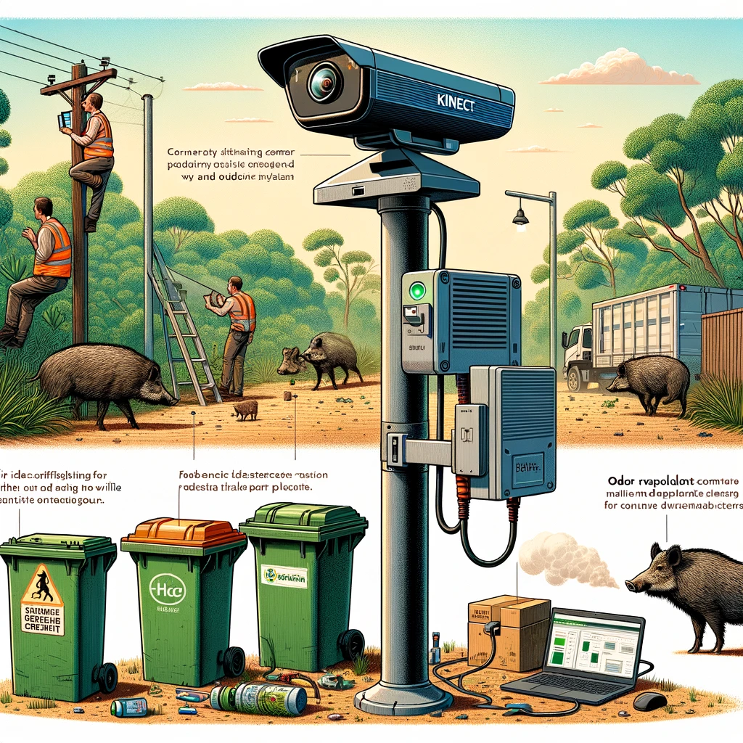
7.0 CONCLUSION AND RECOMMENDATIONS
7.1 KINECT-BASED DETERRENT SYSTEM WITH AN ODOR-REPELLENT
Third in the contest with 48.64/100 → REJECTED
Lowest feasibility score → The system is sufficiently applicable but has lower acceptability due to odor and requires regular maintenance, which affects its practicality.
Lowest monetary cost score → Post-implementation expenses drastically increase the monetary cost of the solution.
The odor repellent may cause brief environmental discomfort, and the electronics use minimal energy, making the system environmentally considerate.
Fig. 15: Animated Representation of Kinect-Based Deterrent System with an Odor-Repellent by GPT4 [66]

Slide 58
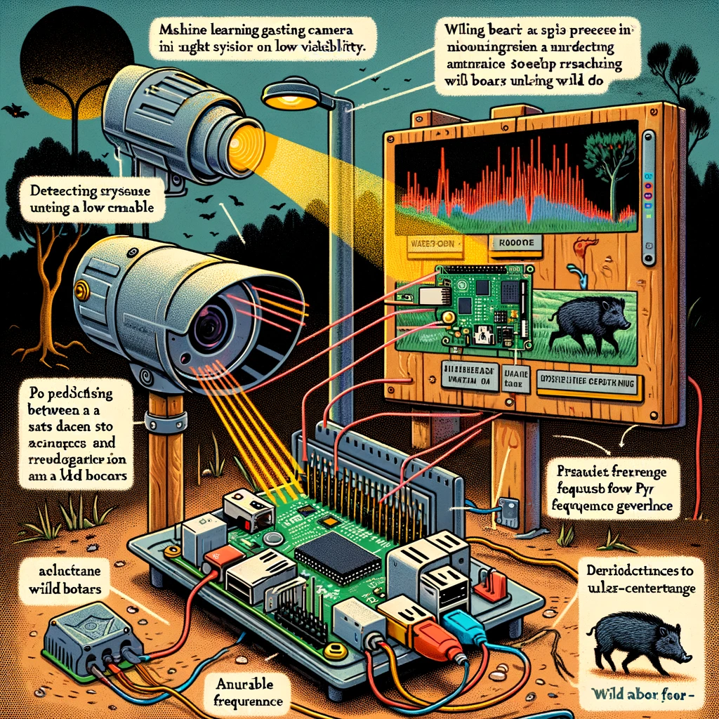
7.0 CONCLUSION AND RECOMMENDATIONS
7.2 MACHINE LEARNING-BASED ACOUSTIC DETERRENT SYSTEM
Second in the contest with 56.52/100 → REJECTED
It is almost certain that the HC residents will accept the solution, yet its setup is complex and needs broad technical expertise. The advanced ML algorithm for boar detection is innovative but unproven.
The total monetary value is well above the budget.
Raspberry Pi and similar electronics are energy-efficient but not entirely sustainable; ML can decrease efficiency by triggering unneeded activations.
Fig. 15: Animated Representation of Machine Learning-Based Acoustic Deterrent System by GPT4 [66]

Slide 59
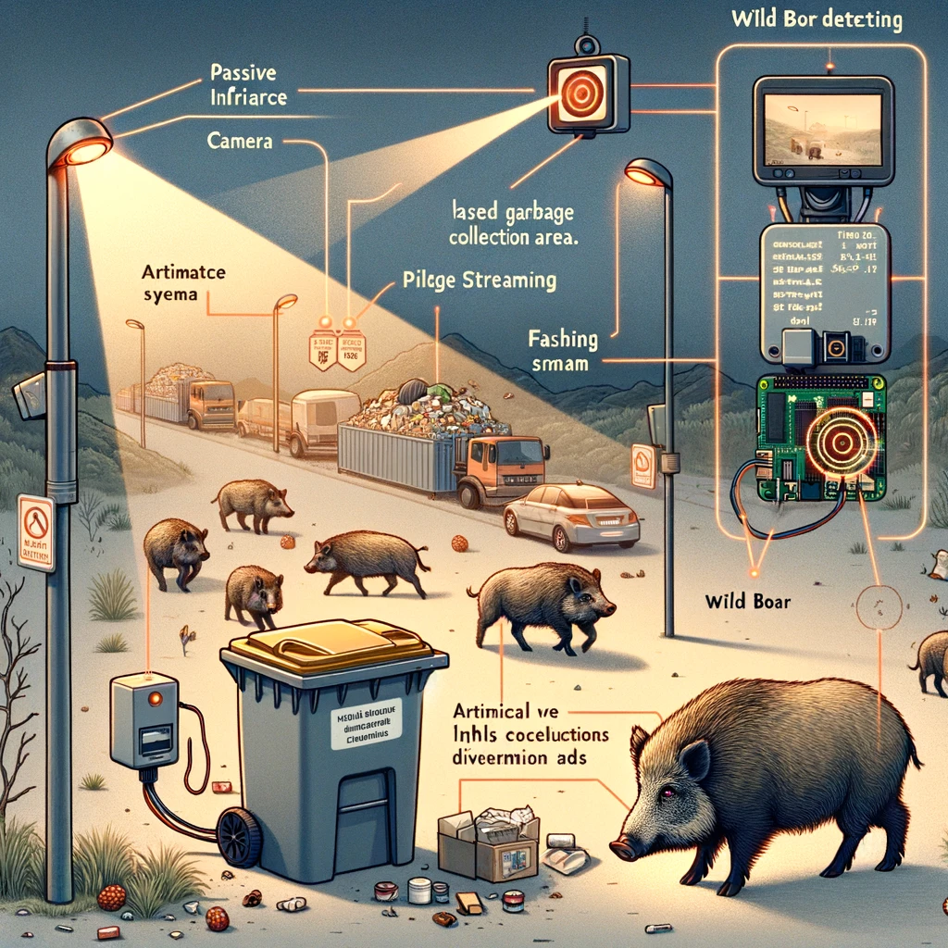
7.0 CONCLUSION AND RECOMMENDATIONS
7.3 SENSOR AND ARTIFICIAL INTELLIGENCE-BASED VISUAL DETERRENT SYSTEM
First in the contest with 74.78/100 → ACCEPTED
Highest feasibility score → Highly acceptable and applicable but lacks practicality because training and installation of the YOLO algorithm requires high level expertise
Highest monetary cost score → The total monetary value is well within the budget.
Highest environmental safety impact score → The Raspberry Pi and PIR sensors use little energy, and LEDs are efficient; the system saves power by activating only when needed.
Fig. 15: Animated Representation of Sensor and Artificial Intelligence-Based Visual Deterrent System by GPT4 [66]

Slide 60
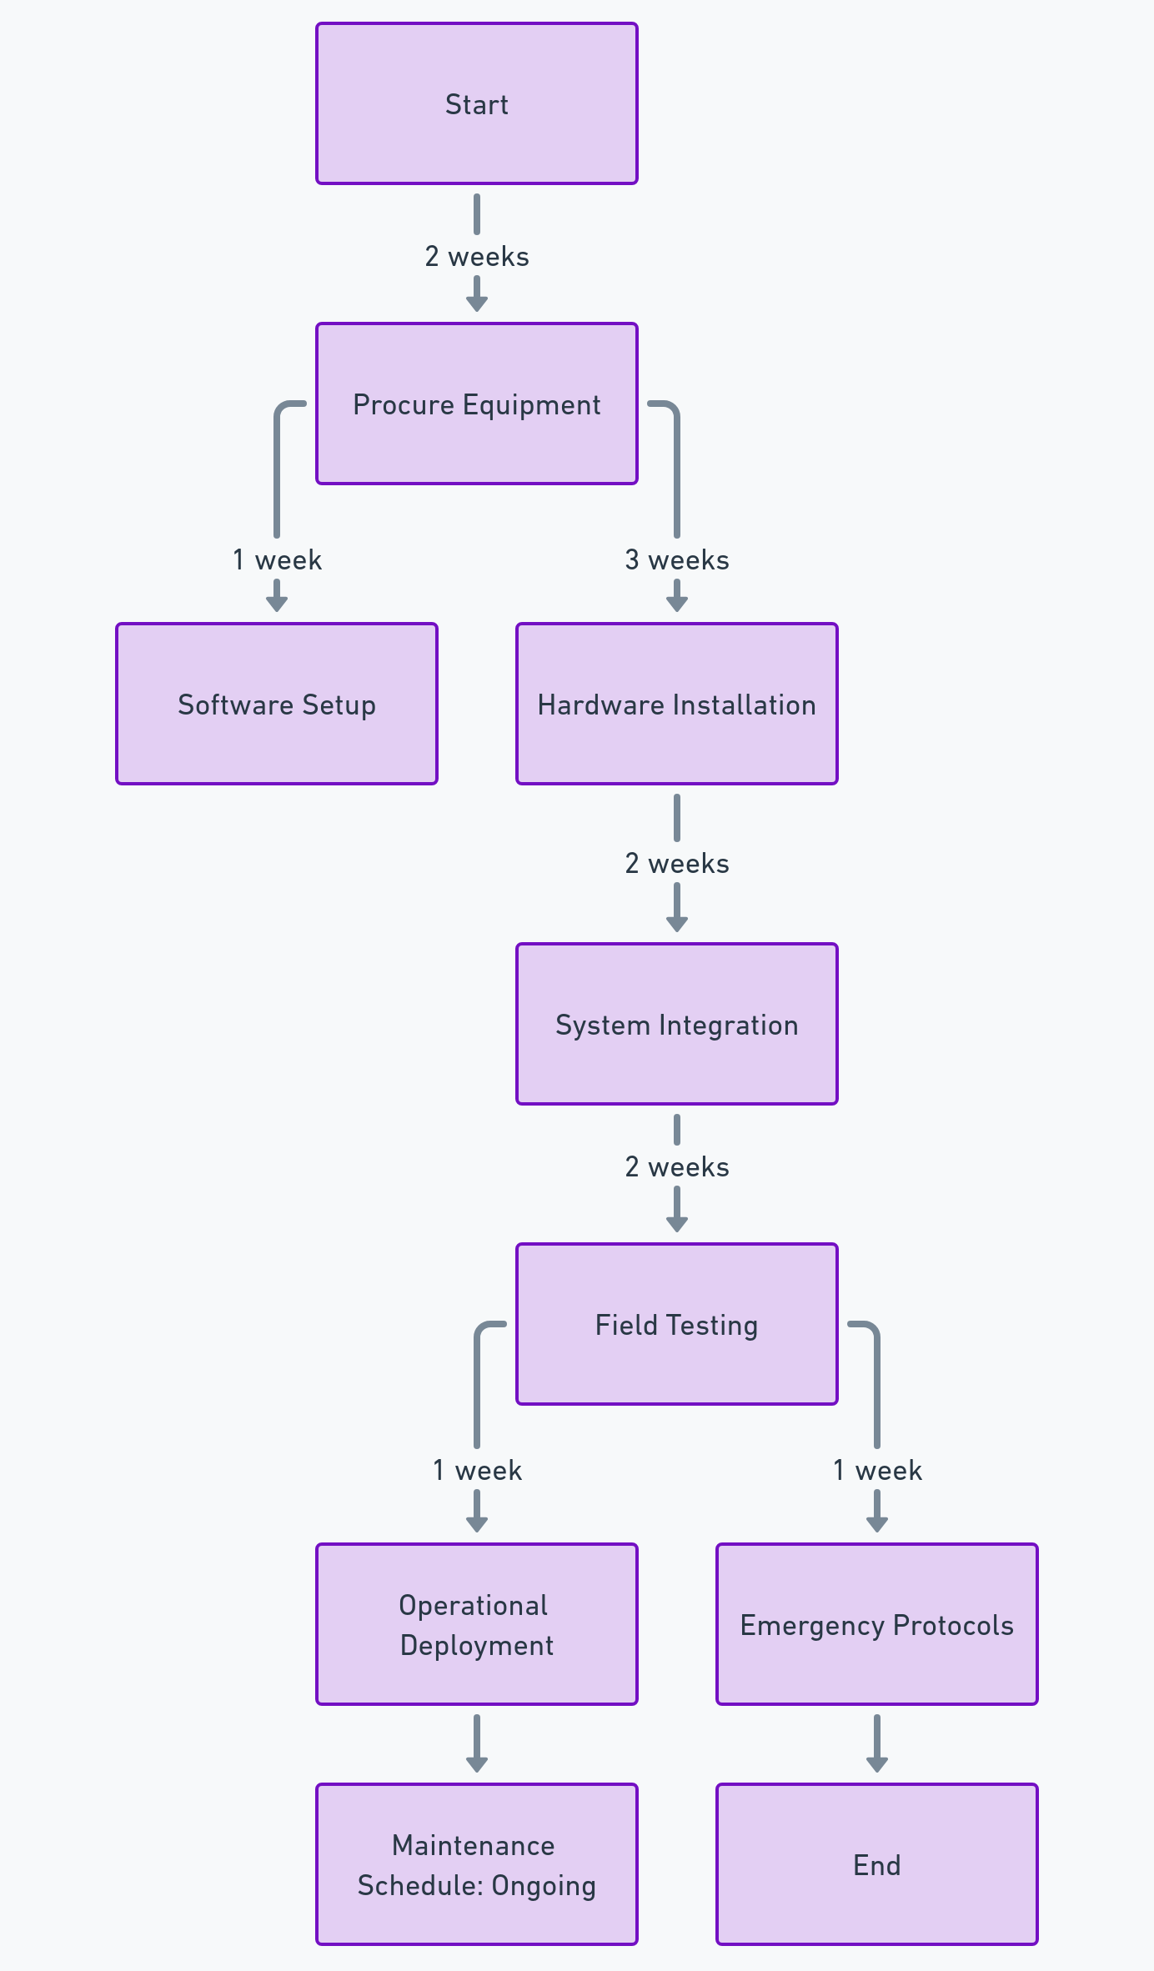
7.0 CONCLUSION AND RECOMMENDATIONS
ACTION PLAN
1. Obtain Equipment: Obtain PIR sensors, Raspberry Pi units, cameras, and LED light strips
2. Software Setup: Have a software engineer install and configure the YOLO V3 algorithm on the Rpis
3. Hardware Installation: Task HC electricians with installing PIR sensors and cameras on selected streetlights
4. System Integration: Connect cameras to Rpis and ensure communication with PIR sensors
Fig. 16: Flowchart of the Action Plan [67]

Slide 61
7.0 CONCLUSION AND RECOMMENDATIONS
ACTION PLAN
5. Field Testing: Test the complete setup in the HC for functionality and detection accuracy
6. Operational Deployment: Activate the system to use LEDs for wild boar deterrence upon detection
7. Maintenance Schedule: Establish a regular maintenance routine for the entire system
8. Emergency Protocols: Develop and document procedures for scenarios where the system fails to deter wild boars
Fig. 16: Flowchart of the Action Plan [67]

Slide 62

8.0 References

Slide 63
6.0 References
[1] C. Conejero, R. Castillo-Contreras, C. González-Crespo, E. Serrano, G. Mentaberre, S. Lavín, and J. R. López-Olvera, "Past experiences drive citizen perception of wild boar in urban areas," Mammalian Biology: Zeitschrift für Säugetierkunde, vol. 96, pp. 68-72, May 2019. [Online]. Available: Springer Nature Journals, https://www.springernature.com/gp/products/journals. [Accessed Oct. 28, 2023].
[2] C. Hunold and M. Mazuchowski, "Human-wildlife coexistence in urban wildlife management: insights from nonlethal predator management and rodenticide bans," Animals, vol. 10, no. 11, pp. 1-15, November 2020. [Online]. Available: Scopus, https://www.scopus.com/search/form.uri?display=basic#basic. [Accessed Oct. 28, 2023].
[3] S. Tampakis, V. Andrea, T. Panagopoulos, P. Karanikola, R. Gkarmiri, and T. Georgoula, "Managing the conflict of human-wildlife coexistence: A community-based approach," Land, vol. 12, no. 832, p. 832+, April 2023. [Online]. Available: Scopus, https://www.scopus.com/search/form.uri?display=basic#basic. [Accessed Oct. 28, 2023].
[4] S. Cahill, F. Llimona, L. Cabañeros, and F. Calomardo, "Characteristics of wild boar (Sus scrofa) habituation to urban areas in the Collserola Natural Park (Barcelona) and comparison with other locations," Animal Biodiversity and Conservation, vol. 35, no. 2, pp. 221-233, 2012. [Online]. Available: Directory of Open Access Journals, https://doaj.org. [Accessed Oct. 28, 2023].
[5] Anadolu Agency, “Bodrum locals feeding wild boars to keep them in the forest,” Hürriyet Daily News: Arts & Life, p. 3, Jun. 15, 2018. [Online]. Available: Hürriyet Daily News, https://www.hurriyetdailynews.com. [Accessed Oct. 28, 2023].
[6] H. Albayrak, E. Ozan, and A. Cavunt, "A serological survey of selected pathogens in wild boar (Sus scrofa) in northern Turkey," European Journal of Wildlife Research, vol. 59, no. 6, pp. 893-897, June 2013. [Online]. Available: Springer Nature Journals, https://www.springernature.com/gp/products/journals. [Accessed Oct. 28, 2023].
[7] R. Castillo-Contreras, J. Carvalho, E. Serrano, G. Mentaberre, X. Fernández-Aguilar, A. Colom, C. González-Crespo, S. Lavín, and J. R. López-Olvera, "Urban wild boars prefer fragmented areas with food resources near natural corridors," Science of the Total Environment, vol. 615, pp. 282-288, January 2018. [Online]. Available: ScienceDirect, https://www.sciencedirect.com. [Accessed Oct. 28, 2023].
[8] X. J. Meng, D. S. Lindsay, and N. Sriranganathan, "Wild boars as sources for infectious diseases in livestock and humans," Philosophical Transactions: Biological Sciences, vol. 364, no. 1530, pp. 2697-2707, September 2009. [Online]. Available: JSTOR Journals, https://www.jstor.org. [Accessed Oct. 29, 2023].
[9] T. Ikeda, N. Kuninaga, T. Suzuki, S. Ikushima, and M. Suzuki, "Tourist-wild boar (Sus scrofa) interactions in urban wildlife management," Global Ecology and Conservation, vol. 18, May 2019. [Online]. Available: ScienceDirect, https://www.sciencedirect.com. [Accessed Oct. 28, 2023].
[10] J. Carpio, M. Apollonio, and P. Acevedo, "Wild ungulate overabundance in Europe: contexts, causes, monitoring and management recommendations," Mammal Review, vol. 51, no. 1, pp. 95-108, January 2021. [Online]. Available: OAIster, https://www.oclc.org/en/oaister.html. [Accessed Oct. 28, 2023].

Slide 64
6.0 References
[11] L. Nelli, B. Schehl, R. A. Stewart, D. J. McCafferty, C. Scott, S. Ferguson, and S. MacMillan, "Predicting habitat suitability and connectivity for management and conservation of urban wildlife: A real-time web application for grassland water voles," Journal of Applied Ecology, vol. 59, no. 4, pp. 1072-1085, April 2022. [Online]. Available: Scopus, https://www.scopus.com/search/form.uri?display=basic#basic. [Accessed Oct. 28, 2023].
[12] L. L. Griffin, A. Haigh, K. Conteddu, M. Andaloc, S. Ciuti, and P. McDonnell, "Reducing risky interactions: Identifying barriers to the successful management of human-wildlife conflict in an urban parkland," People and Nature, vol. 4, no. 4, pp. 918-930, August 2022. [Online]. Available: Scopus, https://www.scopus.com/search/form.uri?display=basic#basic. [Accessed Oct. 28, 2023].
[13] C. González-Crespo, B. Martínez-López, C. Conejero, R. Castillo-Contreras, E. Serrano, J. M. López-Martín, S. Lavín, and J. R. López-Olvera, "Predicting human-wildlife interaction in urban environments through agent-based models," Landscape and Urban Planning, vol. 240, no. 104878, December 2023. [Online]. Available: ScienceDirect, https://www.sciencedirect.com. [Accessed Oct. 28, 2023].
[14] F. Takeda, "Generation method of the trigger signal for the automatic capture system to the harmful animals with intelligent image processing," in Distributed Computing and Artificial Intelligence: Proc. of the 11th Int. Conf. on Advances in Intelligent Systems and Computing, DCAI 2014, 4-6 June 2014, Salamanca, Spain [Online]. Available: Scopus, https://www.scopus.com/search/form.uri?display=basic#basic. [Accessed: Oct. 28, 2023].
[15] International Business Times, “A look at the Xbox One Kinect: What it does and what the Xbox One can do without it,” International Business Times, Nov. 25, 2013. [Online]. Available: Scopus, https://www.scopus.com/search/form.uri?display=basic#basic. [Accessed Oct. 28, 2023].
[16] International Business Times, “Xbox One: What’s up for developers, gamers and the Kinect,” International Business Times, Jun. 19, 2014. [Online]. Available: Scopus, https://www.scopus.com/search/form.uri?display=basic#basic. [Accessed Oct. 28, 2023].
[17] J. Wevers, J. Fattebert, J. Casaer, T. Artois, and N. Beenaerts, "Trading fear for food in the Anthropocene: How ungulates cope with human disturbance in a multi-use, suburban ecosystem," Science of the Total Environment, vol. 741, no. 140369, November 2020. [Online]. Available: Scopus, https://www.scopus.com/search/form.uri?display=basic#basic. [Accessed Oct. 28, 2023].
[18] S. Rajkumar, A. Hariharan, S. Girish, and M. Arulmurugan, “An efficient vehicle detection and shadow removal using Gaussian mixture models with blob analysis for machine vision application,” SN Computer Science, vol. 4, no. 5, pp. 450-460, September 2023. [Online]. Available: Scopus, https://www.scopus.com/search/form.uri?display=basic#basic. [Accessed Oct. 28, 2023].
[19] T. Kušta, Z. Keken, M. Ježek, and Z. Kůta, "Effectiveness and costs of odor repellents in wildlife-vehicle collisions: A case study in Central Bohemia, Czech Republic," Transportation Research Part D: Transport and Environment, vol. 38, pp. 1-5, July 2015. [Online]. Available: ScienceDirect, https://www.sciencedirect.com. [Accessed Oct. 28, 2023].
[20] M. Bíl, R. Andrášik, T. Bartonička, Z. Křivánková, and J. Sedoník, "An evaluation of odor repellent effectiveness in the prevention of wildlife-vehicle collisions," Journal of Environmental Management, vol. 205, pp. 209-214, January 2018. [Online]. Available: ScienceDirect, https://www.sciencedirect.com. [Accessed Oct. 28, 2023].

Slide 65
6.0 References
[21] S. M. Enosh and N. S. George, "An efficient implementation of protocol operation control unit of FlexRay communication controller," in Proc. of the 2014 1st Int. Conf. on Computational Systems and Communications (ICCSC), 17-18 December 2014, Trivandrum, India [Online]. Available: IEEE Xplore, http://www.ieee.org. [Accessed: 28 Oct. 2023].
[22] Schlageter and D. Haag-Wackernagel, "Evaluation of an odor repellent for protecting crops from wild boar damage," Journal of Pest Science, vol. 85, no. 2, pp. 209-215, June 2012. [Online]. Available: Springer Nature Journals, https://www.springernature.com/gp/products/journals. [Accessed Oct. 28, 2023].
[23] S. Giordano, I. Seitanidis, M. Ojo, D. Adami, and F. Vignoli, "IoT solutions for crop protection against wild animal attacks," in Proc. of the 2018 IEEE Int. Conf. on Environmental Engineering (EE), 12-14 March 2018, Milan, Italy [Online]. Available: IEEE Xplore, http://www.ieee.org. [Accessed: 28 Oct. 2023].
[24] D. Ranparia, G. Singh, A. Rattan, H. Singh, and N. Auluck, "Machine learning-based acoustic repellent system for protecting crops against wild animal attacks," in Proc. of the 2020 IEEE 15th Int. Conf. on Industrial and Information Systems (ICIIS), 26-28 November 2020, Rupnagar, India [Online]. Available: IEEE Xplore, http://www.ieee.org. [Accessed: 28 Oct. 2023].
[25] M. Dubovečak, E. Dumić, and A. Bernik, “Face detection and recognition using Raspberry PI Computer,” Technical Journal / Tehnicki Glasnik, vol. 17, no. 3, pp. 346-352, September 2023. [Online]. Available: The Belt and Road Initiative Reference Source, https://www.ebsco.com/products/research-databases/belt-and-road-initiative-reference-source [Accessed Oct. 28, 2023].
[26] G. Singh, I. Gupta, J. Singh, and N. Kaur, “Face recognition using open-source computer vision library (OpenCV) with Python,” in Proc. of the 2022 10th Int. Conf. on Reliability, Infocom Technologies and Optimization (Trends and Future Directions) (ICRITO), 13-14 October 2022, Noida, India [Online]. Available: IEEE Xplore, http://www.ieee.org. [Accessed: 28 Oct. 2023].
[27] A. Pradeep, M. Asrorov, and M. Quronboyeva, “Advancement of sign language recognition through technology using Python and OpenCV,” in Proc. of the 2023 7th Int. Multi-Topic ICT Conf. (IMTIC), 10-12 May 2023, Jamshoro, Pakistan [Online]. Available: IEEE Xplore, http://www.ieee.org. [Accessed: 28 Oct. 2023].
[28] A. Shrivastava, M. Chakkaravathy, and M. A. Shah, “A comprehensive analysis of machine learning techniques in biomedical image processing using convolutional neural network,” in Proc of the 2022 5th Int. Conf. on Contemporary Computing and Informatics (IC3I), 14-16 December 2022, Uttar Pradesh, India [Online]. Available: IEEE Xplore, http://www.ieee.org. [Accessed: 28 Oct. 2023].
[29] P. Simard, D. Steinkraus, and J. Platt, "Best practices for convolutional neural networks applied to visual document analysis," in Proc. of the 7th Int. Conf. on Document Analysis and Recognition, 6 August 2003, Edinburgh, UK [Online]. Available: IEEE Xplore, http://www.ieee.org. [Accessed: 28 Oct. 2023].
[30] R. S. Heffner and H. E. Heffner, "Hearing in domestic pigs (Sus scrofa) and goats (Capra hircus)," Hearing Research, vol. 48, no. 3, pp. 231-240, October 1990. [Online]. Available: Scopus, https://www.scopus.com/search/form.uri?display=basic#basic. [Accessed Oct. 28, 2023].

Slide 66
6.0 References
[31] H. D. Patil and N. F. Ansari, "Intrusion detection and repellent system for wild animals using artificial intelligence of things," in Proc. of the 2022 Int. Conf. on Computing, Communication and Power Technology (IC3P), 7-8 January 2022, Visakhapatnam, India [Online]. Available: IEEE Xplore, http://www.ieee.org. [Accessed: 28 Oct. 2023].
[32] J. Andrews, M. Kowsika, A. Vakil, and J. Li, “A motion-induced passive infrared (PIR) sensor for stationary human occupancy detection,” in Proc. of the 2020 IEEE/ION Position, Location and Navigation Symposium (PLANS), 20-23 April 2020, Portland, USA [Online]. Available: IEEE Xplore, http://www.ieee.org. [Accessed: 28 Oct. 2023].
[33] S. Yang, H. Ge, and Q. Li, “Infrared night camouflage target detection algorithm based on improved YOLO v3,” in Proc of the 2022 IEEE 8th Int. Conf. on Computer and Communications (ICCC), 9-12 December 2022, Chengdu, China [Online]. Available: IEEE Xplore, http://www.ieee.org. [Accessed: 28 Oct. 2023].
[34] M. Sharmila F, C. K. Amal Kumar, A. Varsha D, and E. Sarayu, "Animal repellent system for smart farming using AI and edge computing," in Proc. of the 2022 8th Int. Conf. on Advanced Computing and Communication Systems (ICACCS), 25-26 March 2022, Coimbatore, India [Online]. Available: IEEE Xplore, http://www.ieee.org. [Accessed: 28 Oct. 2023].
[35] D. Carniato, J. Sereno, J. Vicente, J. A. Blanco, M. Scandura, M. Apollonio, P. Palencia, and P. Acevedo, "Implementing practical methods to estimate the population density of wild boar and other wild mammals: field trials and development of automatic identification," EFSA Supporting Publications, vol. 19, no. 9, pp. 1-48, August 2022. [Online]. Available: Academic Search Ultimate, https://www.ebsco.com/products/research-databases/academic-search-ultimate. [Accessed Oct. 28, 2023].
[36] S. McLeod, “Feasibility studies for novel and complex projects: Principles synthesized through an integrative review,” Project Leadership and Society, vol. 2, December 2022. [Online]. Available: ScienceDirect, https://www.sciencedirect.com. [Accessed Oct. 28, 2023].
[37] X. Wang, Z. Du, Y. Wang, J. Wang, S. Huang, Y. Wang, J. Gu, W. Deng, S. Gilmour, J. Li, and Y. Hao, "Impact and cost-effectiveness of biomedical interventions on adult Hepatitis B elimination in China: A mathematical modeling study," Journal of Epidemiology and Global Health, vol. 13, no. 3, pp. 517-527, June 2023. [Online]. Available: Springer Nature Journals, https://www.springernature.com/gp/products/journals. [Accessed Oct. 28, 2023].
[38] D. W. North, "Engineering a safer world: systems thinking applied to safety," Risk Analysis, vol. 34, no. 2, pp. 391-396, February 2014. [Online]. Available: Science Citation Index Expanded, https://clarivate.com/products/scientific-and-academic-research/research-discovery-and-workflow-solutions/webofscience-platform/web-of-science-core-collection/science-citation-index-expanded/. [Accessed Oct. 28, 2023].
[39] J. Rovira, M. Nadal, M. Schuhmacher, and J. L. Domingo, "Human exposure to trace elements through the skin by direct contact with clothing: Risk assessment," Environmental Research, vol. 140, pp. 308-316, July 2015. [Online]. Available: ScienceDirect, https://www.sciencedirect.com. [Accessed Oct. 28, 2023].
[40] P. C. Lyon, C. Mannaris, M. Gray, R. Carlisle, F. V. Gleeson, D. Cranston, F. Wu, and C. C. Coussios, "Large-volume hyperthermia for safe and cost-effective targeted drug delivery using a clinical ultrasound-guided focused ultrasound device," Ultrasound in Medicine & Biology, vol. 47, no. 4, pp. 982-997, April 2021. [Online]. Available: Scopus, https://www.scopus.com/search/form.uri?display=basic#basic. [Accessed Oct. 28, 2023].

Slide 67
6.0 References
[41] G. M. M. Zarco and V. O. Monroy, "Effectiveness of low-cost deterrents in decreasing livestock predation by felids: A case in Central Mexico," Animal Conservation, vol. 17, no. 4, pp. 371-378, August 2014. [Online]. Available: Academic Search Ultimate, https://www.ebsco.com/products/research-databases/academic-search-ultimate. [Accessed Oct. 28, 2023].
[42] W. L. Nyborg, "Determining risk to subjects: Exposure to ultrasound," IRB, vol. 9, no. 3, pp. 1-5, May 1987. [Online]. Available: Scopus, https://www.scopus.com/search/form.uri?display=basic#basic. [Accessed Oct. 28, 2023].
[43] Y. Wang, J. Jian, B. Sun, Y. Wei, D. Pan, J. Cao, and Y. Shen, "Engineering of onsite point-of-care testing of Fe3+ with visual ratiometric fluorescent signals of copper nanoclusters-driven portable smartphone," Sensors and Actuators: B. Chemical, vol. 370, November 2022. [Online]. Available: ScienceDirect, https://www.sciencedirect.com. [Accessed Oct. 28, 2023].
[44] G. Wagner, R. Lukyanenko, and G. Paré, "Artificial intelligence and the conduct of literature reviews," Journal of Information Technology, vol. 37, no. 2, pp. 209-226, June 2022. [Online]. Available: Scopus, https://www.scopus.com/search/form.uri?display=basic#basic. [Accessed Oct. 28, 2023].
[45] K. D. Ward, D. P. Mason, G. Park, and R. Fyall, "Exploring nonprofit advocacy research methods and design: A systematic review of the literature," Nonprofit and Voluntary Sector Quarterly, vol. 52, no. 5, pp. 1210-1231, October 2023. [Online]. Available: Scopus, https://www.scopus.com/search/form.uri?display=basic#basic. [Accessed Oct. 28, 2023].
[46] Wm. J. Gonzenbach and Michael Mitrook, "The market research toolbox: A concise guide for beginners," International Journal of Public Opinion Research, vol. 8, no. 4, pp. 411-412, December 1996. [Online]. Available: Business Source Ultimate, https://www.ebsco.com/products/research-databases/business-source-ultimate. [Accessed Oct. 28, 2023].
[47] C. T. Husbands, "Field research: A sourcebook and field manual R. G. Burgess," The British Journal of Criminology, vol. 23, no. 2, pp. 198–199, April 1983. [Online]. Available: Academic Search Ultimate, https://www.ebsco.com/products/research-databases/academic-search-ultimate. [Accessed Oct. 28, 2023].
[48] A. I. Khalyasmaa, E. L. Zinovieva, and S. A. Eroshenko, "Formation features of criteria for assessing the feasibility of innovative technical solutions," in Proc. of the 2018 3rd Int. Conf. on Human Factors in Complex Technical Systems and Environments (ERGO), 2018, St. Petersburg, Russia [Online]. Available: https://ieeexplore.ieee.org/document/8443920?arnumber=8443920. [Accessed: Mar. 20, 2023].
[49] T. Wu, J. Ruan, C. Chen, and D. Huang, "Field observation and experimental investigation on the breakdown of the air gap of AC transmission line under forest fires," in Proc. of the 2011 IEEE Power Engineering and Automation Conf., 2011, Wuhan, China [Online]. Available: IEEE Xplore, http://www.ieee.org. [Accessed: 28 Oct. 2023].
[50] J. Casaer, P. Jansen, D. Roy, P. Stephens, A. J. Blanco, Y. Liefting, J. Vicente, and G. Smith, "Improvement of information technology tools to collect, process and analyze data on wildlife population," EFSA Supporting Publications, vol. 20, no. 8, pp. 1-22, August 2023. [Online]. Available: Academic Search Ultimate, https://www.ebsco.com/products/research-databases/academic-search-ultimate. [Accessed Oct. 28, 2023].

Slide 68
6.0 References
[51] Hürriyet, "Dolar kuru bugün ne kadar? - Canlı alış satış TL fiyatı ve hesaplama," Bigpara, Hürriyet Gazetecilik ve Matbaacılık A.Ş., 2023. [Online]. Available: https://bigpara.hurriyet.com.tr/doviz/dolar/. [Accessed: Dec. 6, 2023].
[52] Amazon, Inc., "Microsoft 360 Kinect sensor (certified refurbished)," Amazon, 2023. [Online]. Available: https://www.amazon.com/Microsoft-360-Kinect-Sensor-Certified-Refurbished/dp/B005GA1H4C. [Accessed: Dec. 6, 2023].
[53] Amazon, "DIBAIGOU adaptör Xbox Windows adaptörü," Amazon, 2023. [Online]. Available: https://www.amazon.com.tr/DIBAIGOU-Adaptör-Xbox-Windows-Adaptörü/dp/B0BZMZRL6V/ref=sr_1_3?keywords=xbox+kinect&qid=1701901451&sr=8-3. [Accessed: Dec. 6, 2023].
[54] Amazon, "Control programmable controller for industrial computer," Amazon, 2023. [Online]. Available: https://www.amazon.com/Control-Programmable-Controller-Industrial-Computer/dp/B09MN8R6P1/ref=sr_1_2?keywords=programmable+logic+controller&qid=1701901561&sr=8-2. [Accessed: Dec. 6, 2023].
[55] Hagopur AG, "Hagopur Wildschwein-Stopp® Rot 500ml," Hagopur-Shop, 2023. [Online.] Available: https://www.hagopur-shop.de/hagopur-wildschwein-stopp-rot-500ml. [Accessed: Dec. 6, 2023].
[56] Amazon, "Raspberry Pi 3 model B+ yeni versiyon," Amazon, 2023. [Online]. Available: https://www.amazon.com.tr/Raspberry-Pi-Model-Yeni-Versiyon/dp/B07BDR5PDW/ref=sr_1_5?adgrpid=122519971320&hvadid=509781013642&hvdev=c&hvlocphy=1012763&hvnetw=g&hvqmt=b&hvrand=11130177083453177500&hvtargid=kwd-24776539960&hydadcr=5564_2236771&keywords=raspberry+pi&qid=1701901678&sr=8-5. [Accessed: Dec. 6, 2023].
[57] Robotistan, "RPi camera (E) supports night vision," Robotistan.com, 2023. [Online]. Available: https://www.robotistan.com/rpi-camera-e-supports-night-vision. [Accessed: Dec. 6, 2023].
[58] Amazon, "UNI-T UNI-TREND arbitrary generator frequency," Amazon, 2023. [Online]. Available: https://www.amazon.com.tr/UNI-T-UNI-TREND-Arbitrary-Generator-Frequency/dp/B0CDRVWKX7?source=ps-sl-shoppingads-lpcontext&ref_=fplfs&psc=1&smid=AQRCDXP805DZS. [Accessed: Dec. 6, 2023].
[59] Amazon, "Honorall dijital amplifikatör stereo sineması," Amazon, 2023. [Online]. Available: https://www.amazon.com.tr/Honorall-Dijital-Amplifikatör-Stereo-Sineması/dp/B09S3QQWGL?source=ps-sl-shoppingads-lpcontext&ref_=fplfs&psc=1&smid=A34JU7CM7QN3WW. [Accessed: Dec. 6, 2023].
[60] Hepsiburada, "Ege teknik metal 1 mm paslanmaz çelik levha sac plaka 304 kalite 250x1000 mm," Hepsiburada.com, 2023. [Online]. Available: https://www.hepsiburada.com/ege-teknik-metal-1-mm-paslanmaz-celik-levha-sac-plaka-304-kalite-250x1000-mm-p-HBCV000047Z8XH?magaza=MetalDepom. [Accessed: Dec. 6, 2023].

Slide 69
6.0 References
[61] Robitshop, "Ayarlanabilir PIR hareket algılama sensörü HC-SR501," Robitshop.com, 2023. [Online]. Available: https://www.robitshop.com/urun/ayarlanabilir-pir-hareket-algilama-sensoru-yesil-hc-sr501. [Accessed: Dec. 6, 2023].
[62] AliExpress, "LED light strip 16 inches," AliExpress, 2023. [Online]. Available: https://tr.aliexpress.com/item/1005003733083955.html. [Accessed: Dec. 6, 2023].
[63] T. Borgert, "Potentials of a friction-induced recycling process to improve resource and energy efficiency in manufacturing technology," Int. J. Mater. Forming, vol. 16, no. 6, November 2023. [Online]. Available: EBSCOhost, https://doi.org/10.1007/s12289-023-01785-w. [Accessed: Dec. 6, 2023].
[64] Z. Liu, "Dynamic role of green energy efficiency and climate technologies in realizing environmental sustainability: Fresh insights from China," Front. Environ. Sci., vol. 10, September 2022. [Online]. Available: EBSCOhost, https://doi.org/10.3389/fenvs.2022.908470. [Accessed: Dec. 6, 2023].
[65] J. S. B. Martins, "Enhancing network slicing architectures with machine learning, security, sustainability and experimental networks integration," IEEE Access, vol. 11, pp. 69144-69163, January 2023. [Online]. Available: EBSCOhost, https://doi.org/10.1109/ACCESS.2023.3292788. [Accessed: Dec. 6, 2023].
[66] OpenAI, "OpenAI Chat," OpenAI, 2023. [Online]. Available: https://chat.openai.com. [Accessed: Dec. 6, 2023].
[67] Lucid Software Inc., "Diagram Software," Lucidchart, 2023. [Online]. Available: https://www.lucidchart.com/pages/landing/diagram-software. [Accessed: Dec. 6, 2023].

Slide 70
Thank you for listening!

